Slide 1
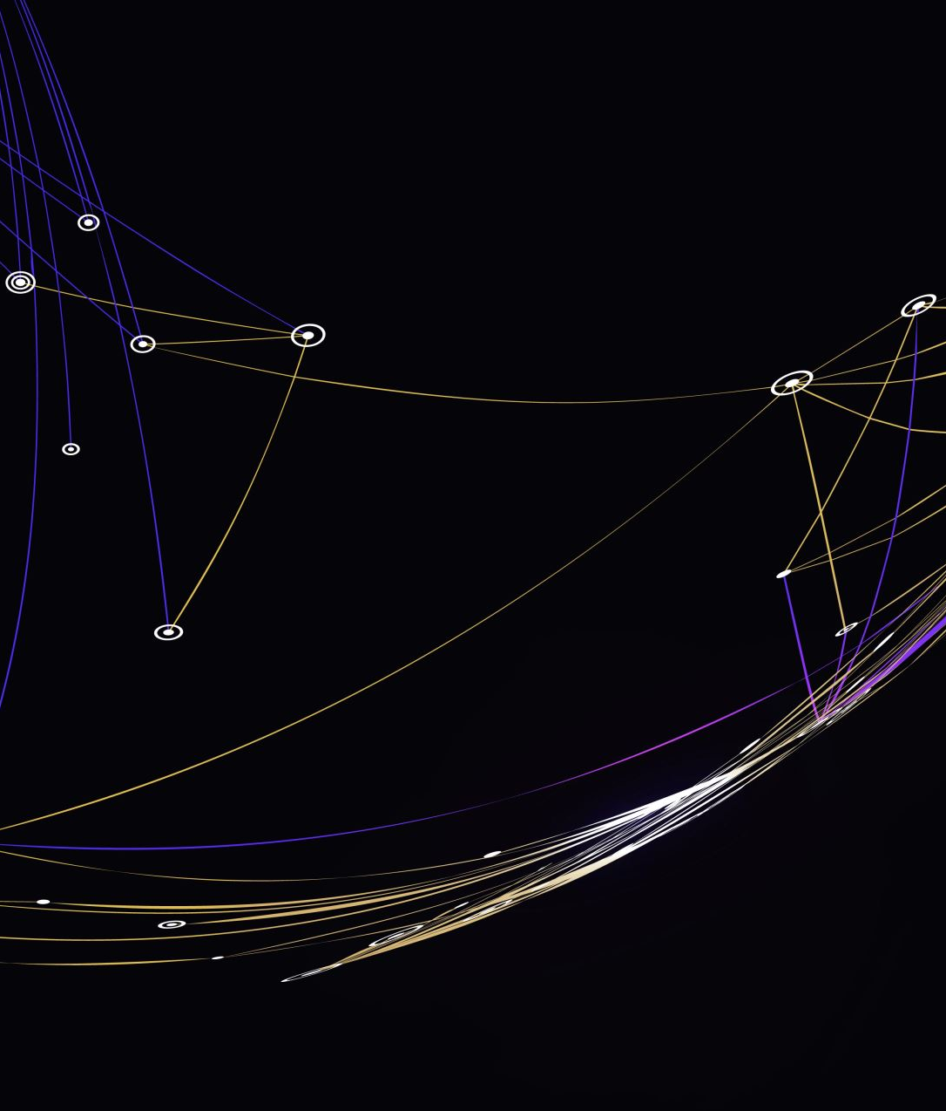
Bayesian Network Model for Safety Integrity Assessment
A Safety Instrumented Function Case Study

Slide 2
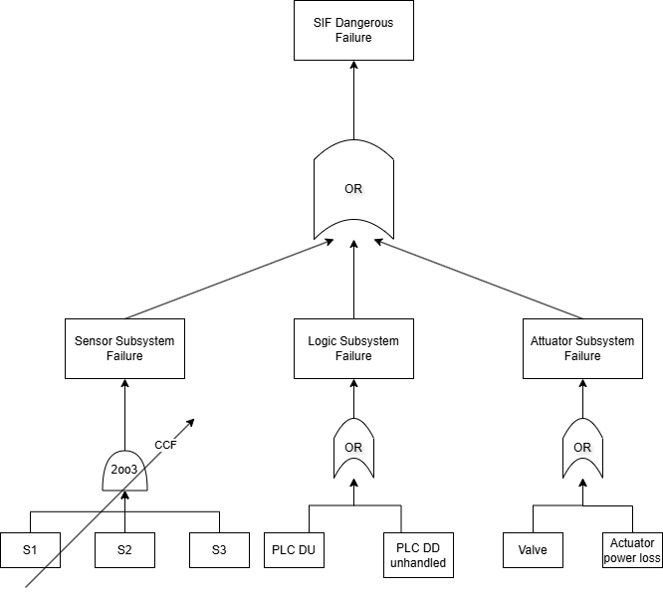
System Description
The system under analysis is a Safety Instrumented Function (SIF), it is an automated safety mechanism designed to bring a controlled industrial process to a safe state upon detection of a hazardous condition.
The Fault Tree is rooted at the Top Event: “SIF fails to respond to a process demand”. This top event is decomposed using an OR gate into the three independent subsystem failure events, reflecting the series architecture of the SIF: any single subsystem failure is sufficient to cause overall SIF failure.

Slide 3
Failure Classification
Safety:
Safe failure: the failure causes the system to move towards or into the safe state, even without a process demand.
Dangerous failure: the failure prevents the SIF from responding correctly to a process demand.
Detection:
Detected (D): the failure is identified by the component’s internal online diagnostics.
Undetected (U): the failure is silent, not revealed by online diagnostics.

Slide 4
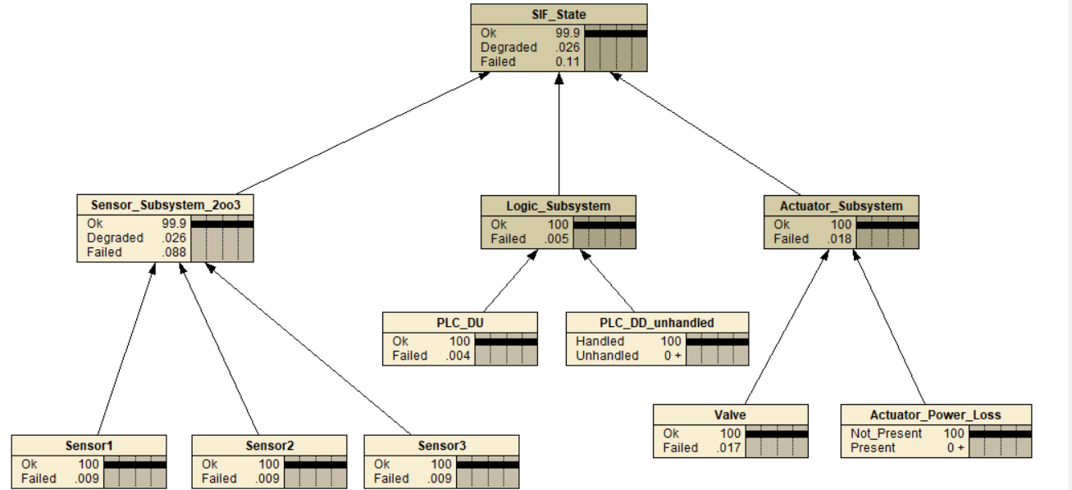
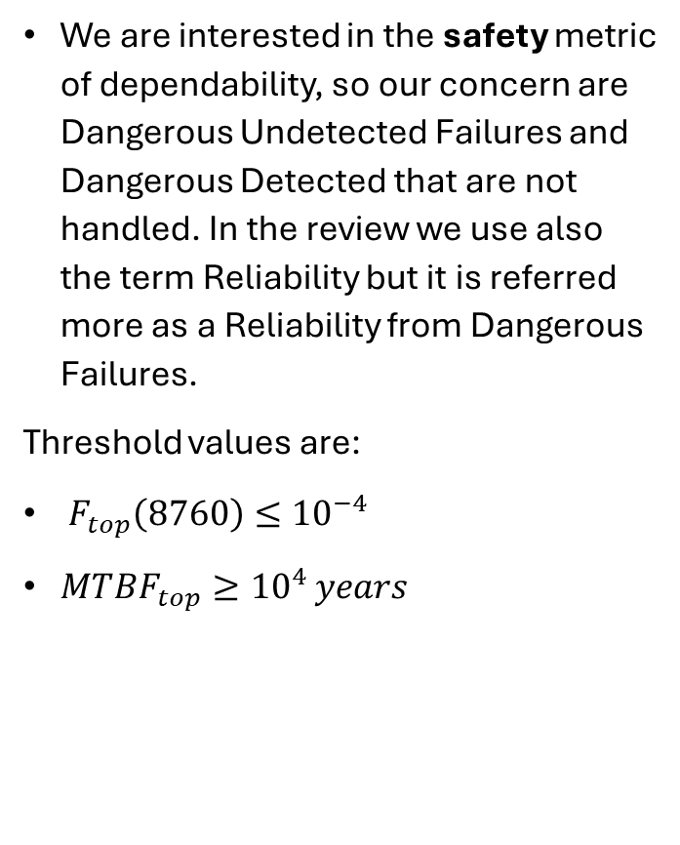
Bayesian Network
We are interested in the safety metric of dependability, so our concern are Dangerous Undetected Failures and Dangerous Detected that are not handled. In the review we use also the term Reliability but it is referred more as a Reliability from Dangerous Failures.
Threshold values are:
$F_{top}\left(8760\right)≤{10}^{−4}$
$MTBF_{top}≥{10}^{4 }years$

Slide 5


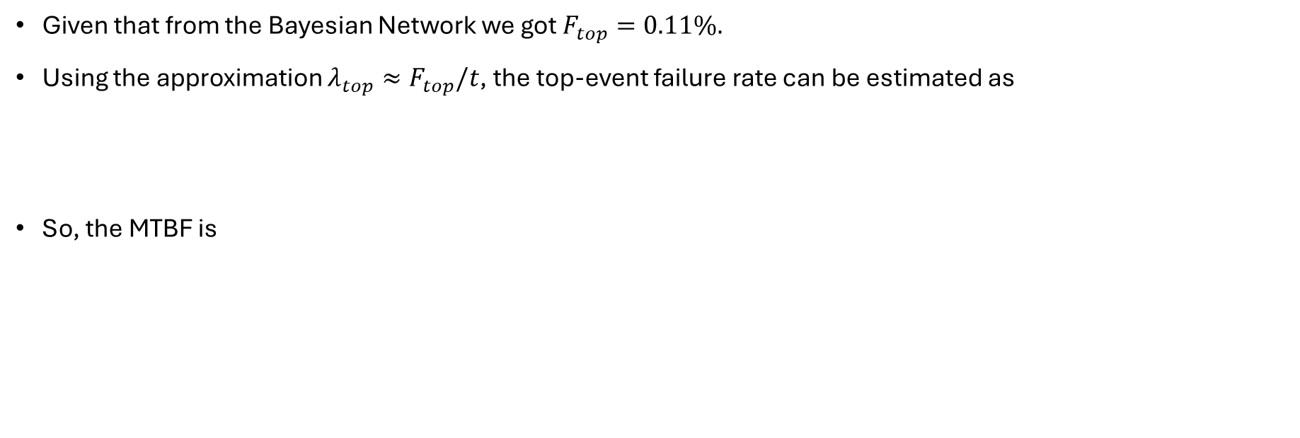
Dependability Results
Given that from the Bayesian Network we got $F_{top}=0.11\%.$
Using the approximation $λ_{top}≈F_{top}/t$, the top-event failure rate can be estimated as
So, the MTBF is

Slide 6
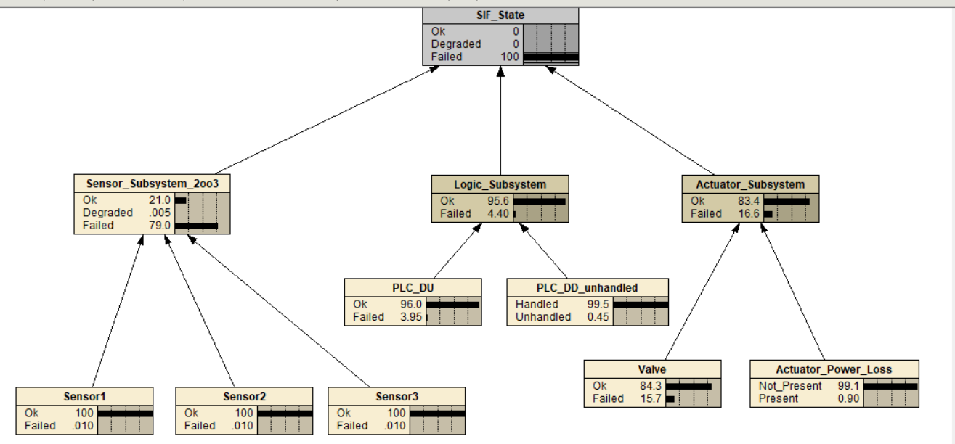
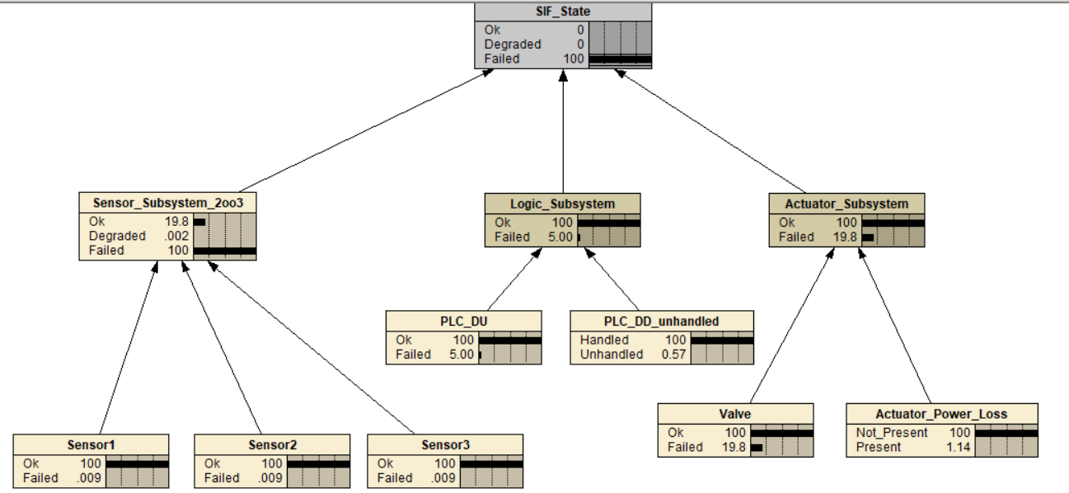
Inference and MPE on Failed state
Inference
MPE

